Slide 1
Measuring Malaria in Complex Transmission Systems
A Time-at-Risk Based Approach
Alec Georgoff
MMC Meeting, Bangkok, Thailand
November 30, 2018
Notes:
Draw picture of malaria life cycle

Slide 2
Objectives

Slide 3
Objectives
Mathematical
Underpinnings
The basics of mosquito math
Vector-Based
Approach
Multiple locations in one equation
Simple
Example
One village, one forest
Expanded
Example
More villages, more forests!!
R
Implementation
Making computers do the hard math

Slide 4
Objectives
Visualizations
Seeing is believing
Future Directions
Our plans moving forward

Slide 5
Mathematical Underpinnings

Slide 6
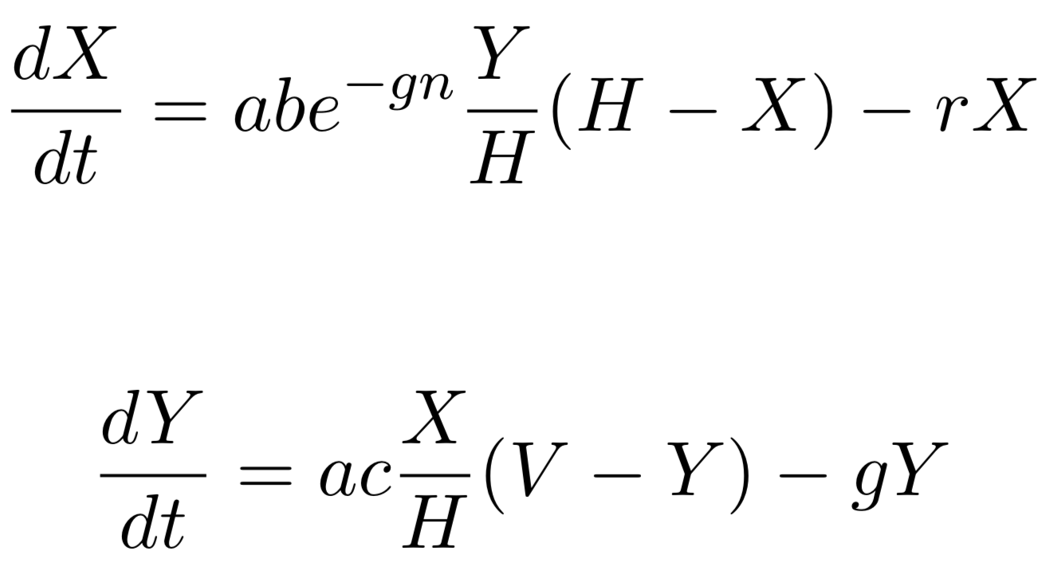
Ross-Macdonald Equations
Infected Humans
Infected Mosquitoes
Notes:
Two equations link together two key parameters (X and Y)

Slide 7
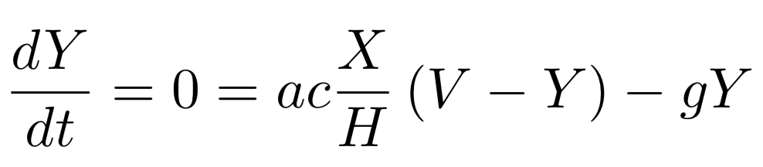
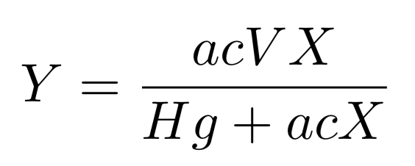
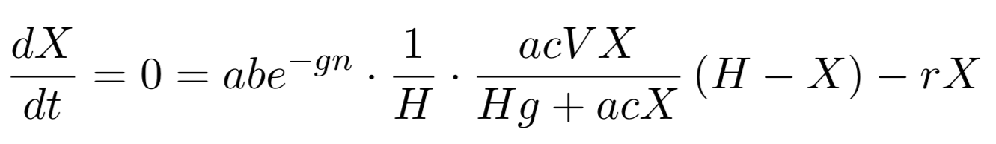
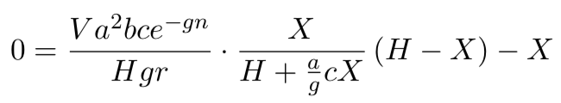
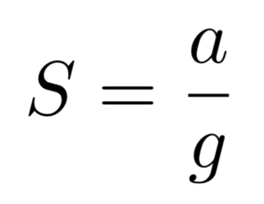
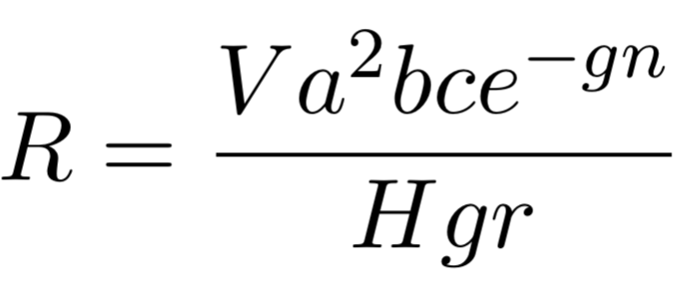
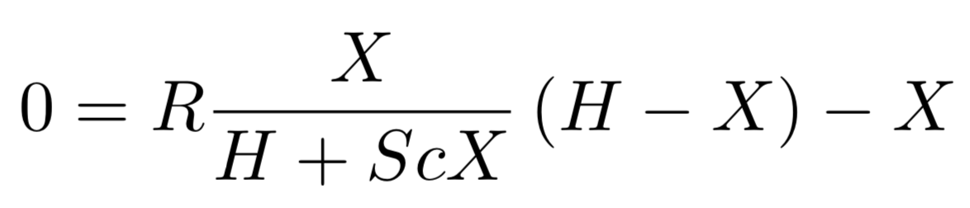
Equilibrium Assumptions
Notes:
Key takeaway: assuming steady state, we can relate X and R in one equation

Slide 8
Equilibrium Assumptions

Slide 9
Equilibrium Assumptions

Slide 10
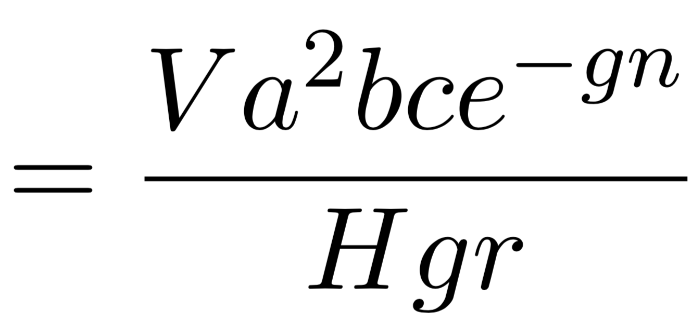
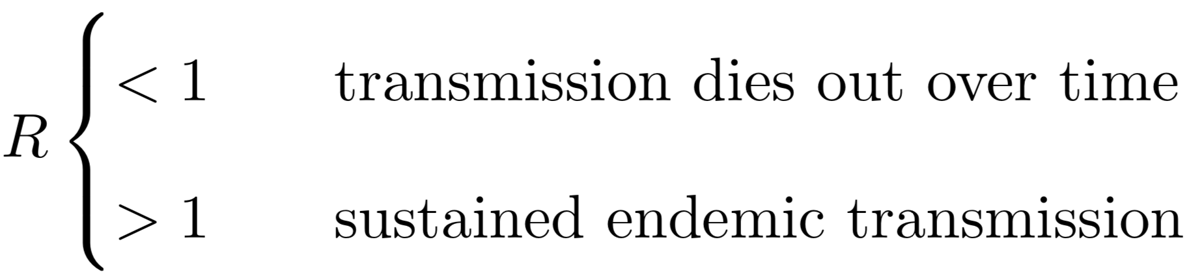
Reproductive Rate
Notes:
Combines environmental parameters into one summary parameter
Threshold for elimination

Slide 11
Vector-Based Approach
Notes:
Use vectors to store values of the same variable in different places

Slide 12
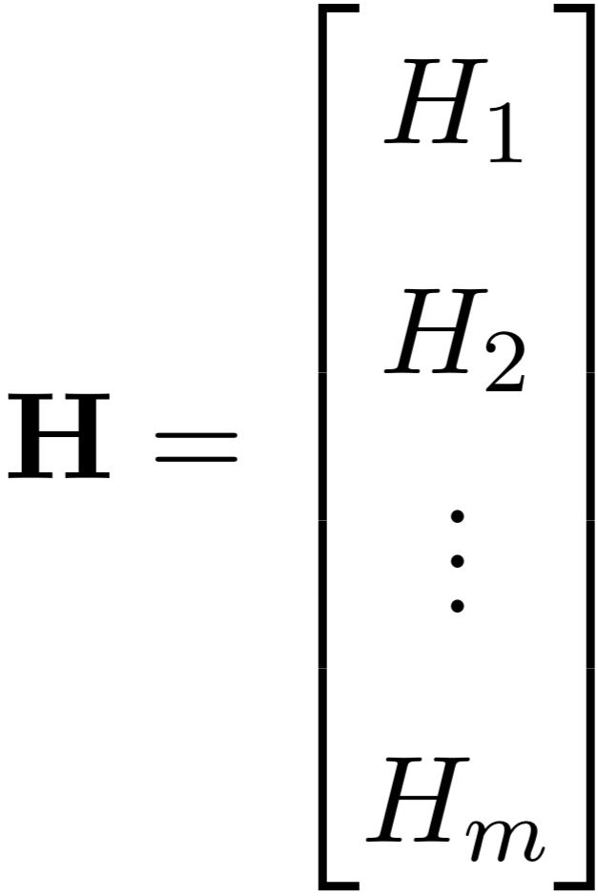
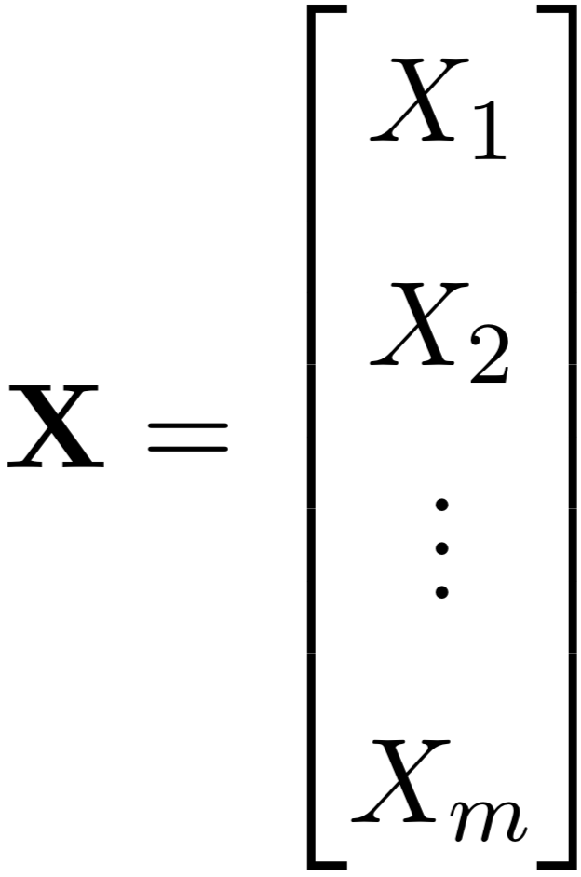
Vectors of Variables

Slide 13
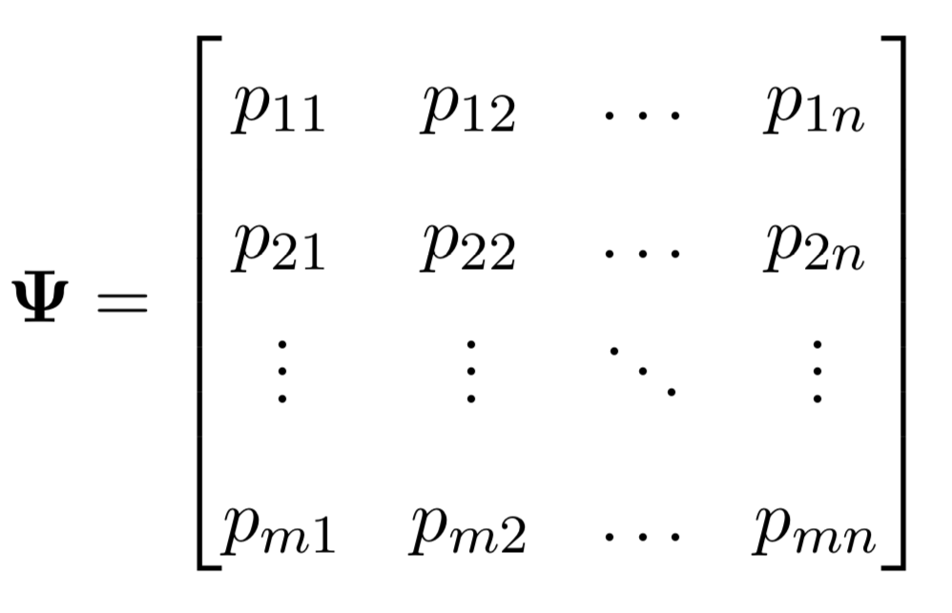
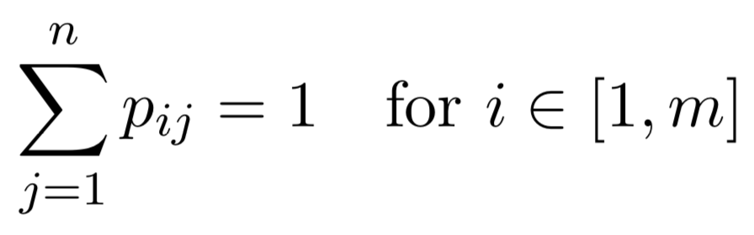
Time-at-Risk (TaR)
Notes:
Describes how people spend their time
Each row sums to one

Slide 14


Scaling by Time-at-Risk
Notes:
Can now use psi to scale by time at risk

Slide 15
Ross-Macdonald Equations
Notes:
Back to RM equations from before

Slide 16
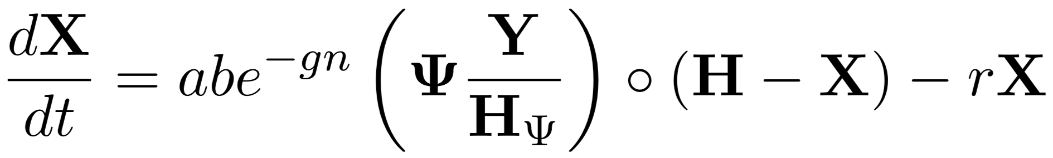
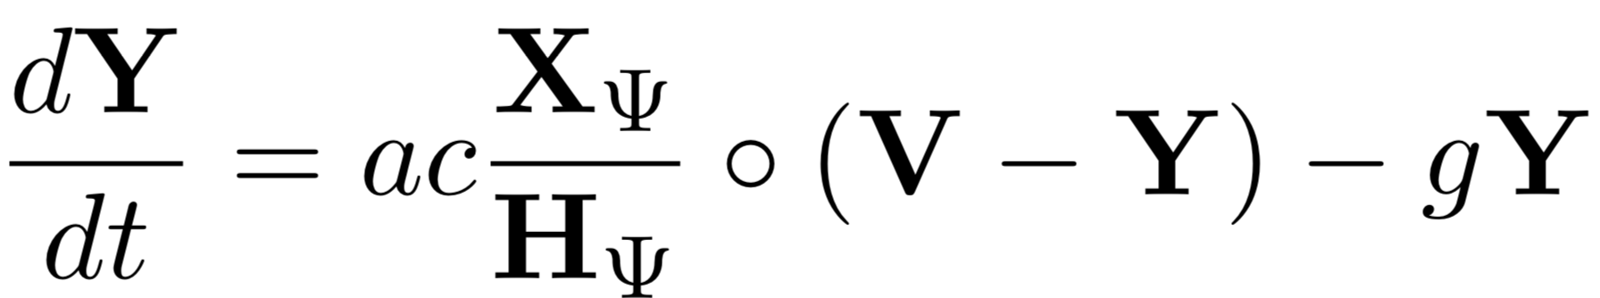
Ross-Macdonald Equations
Notes:
…converted to use vectors and psi matrix

Slide 17
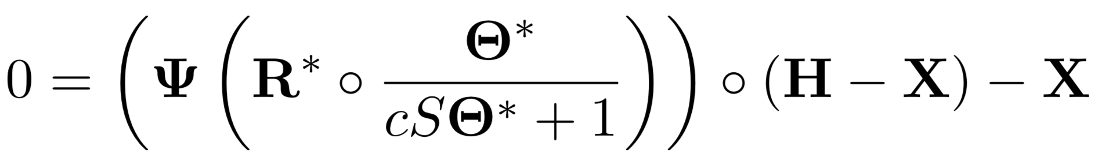
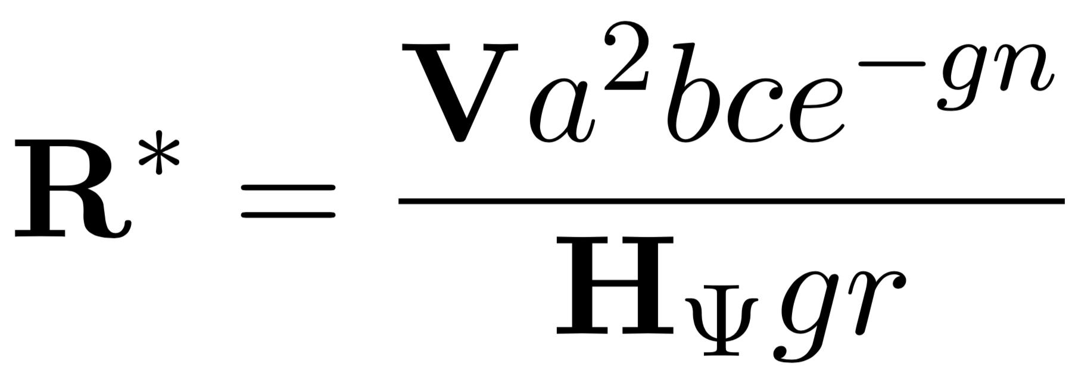
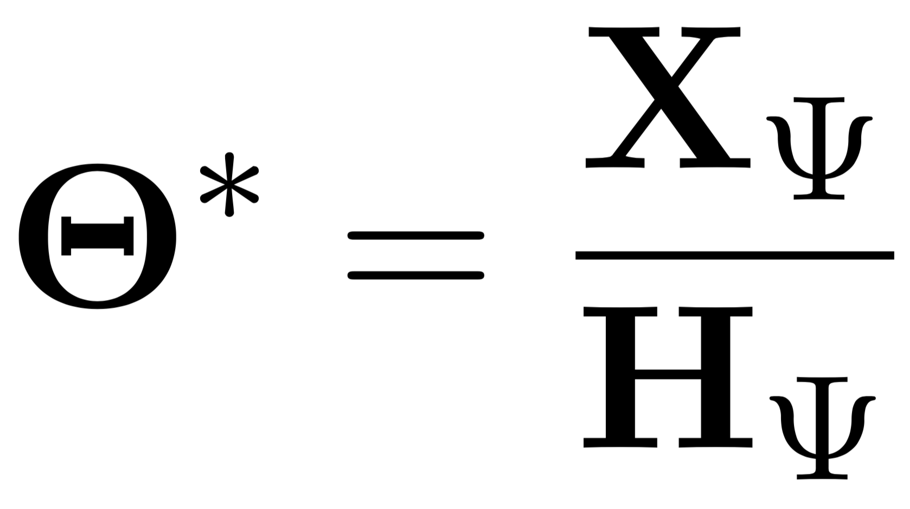
Equilibrium Assumptions
Notes:
Using same steady state assumptions as before, we get equation relating X and R

Slide 18
Simple Example

Slide 19
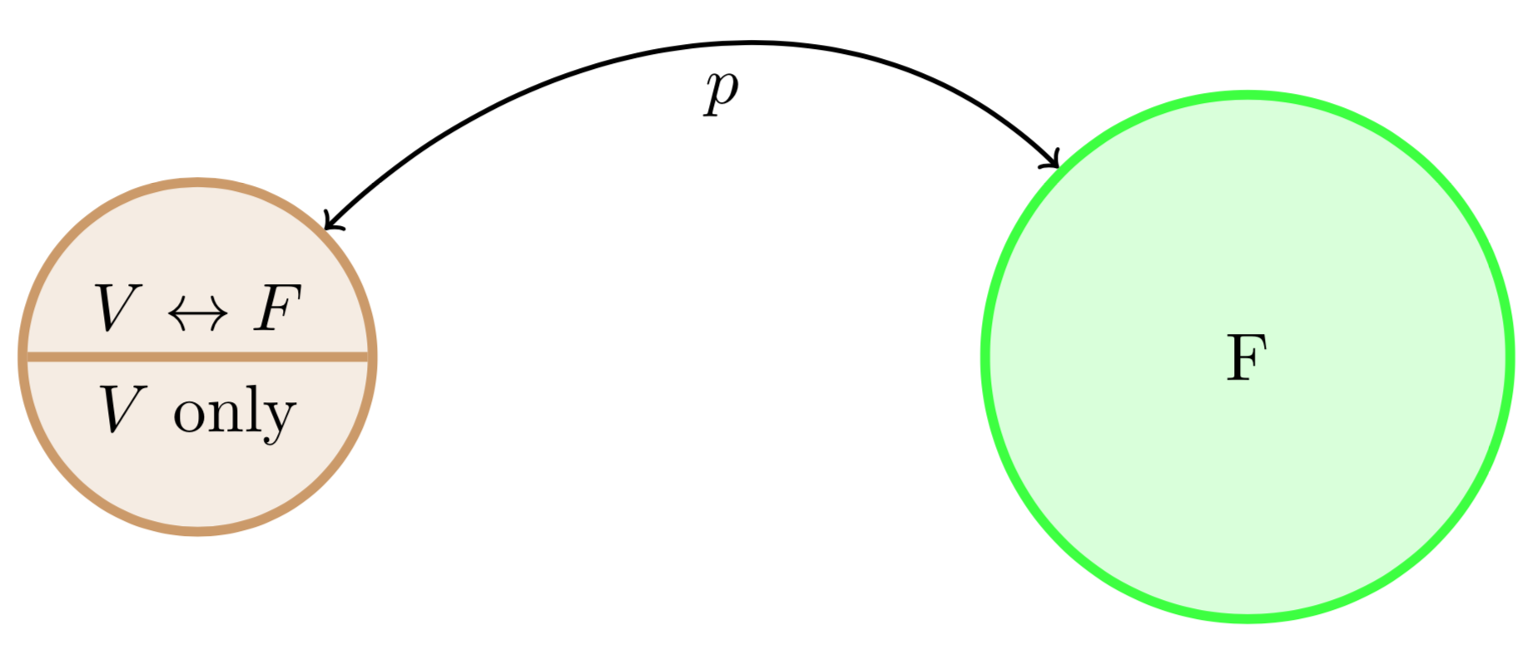
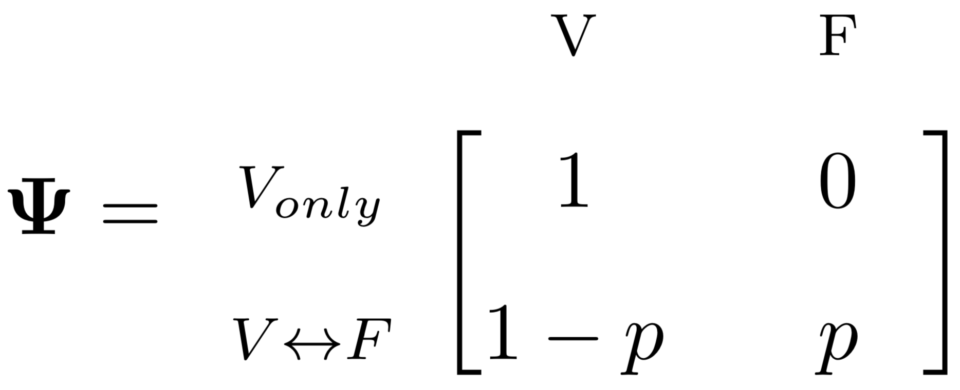
Simple Example: One Village, One Forest
Notes:
Simplest possible example
Walk through psi matrix

Slide 20
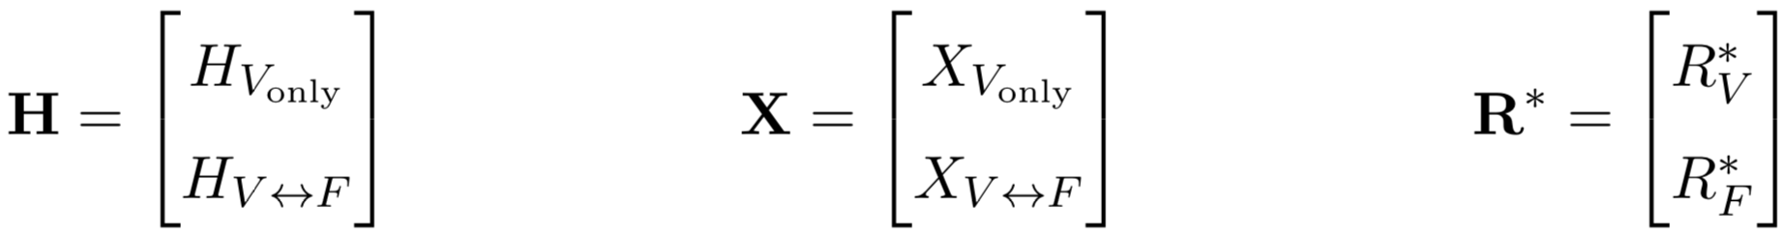
Simple Example: One Village, One Forest

Slide 21
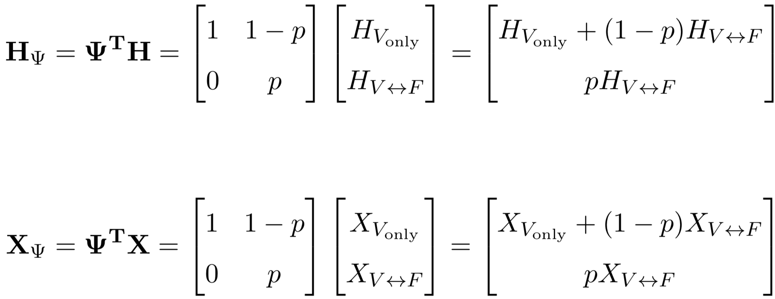
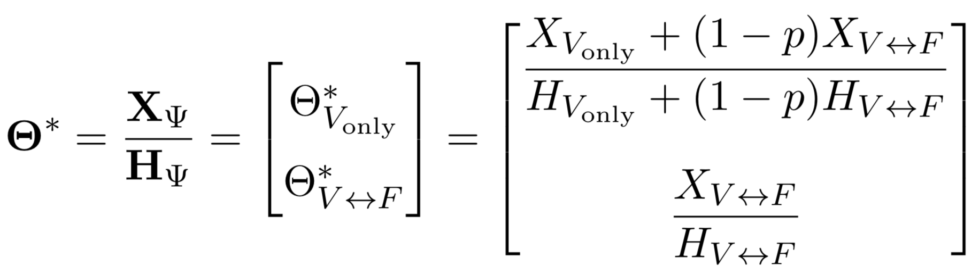
Simple Example: One Village, One Forest
Notes:
Show how populations are scaled

Slide 22
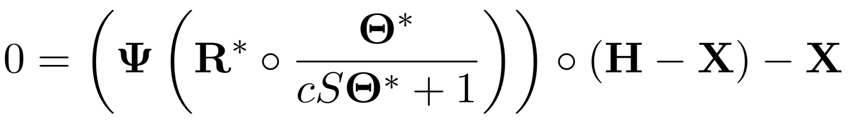
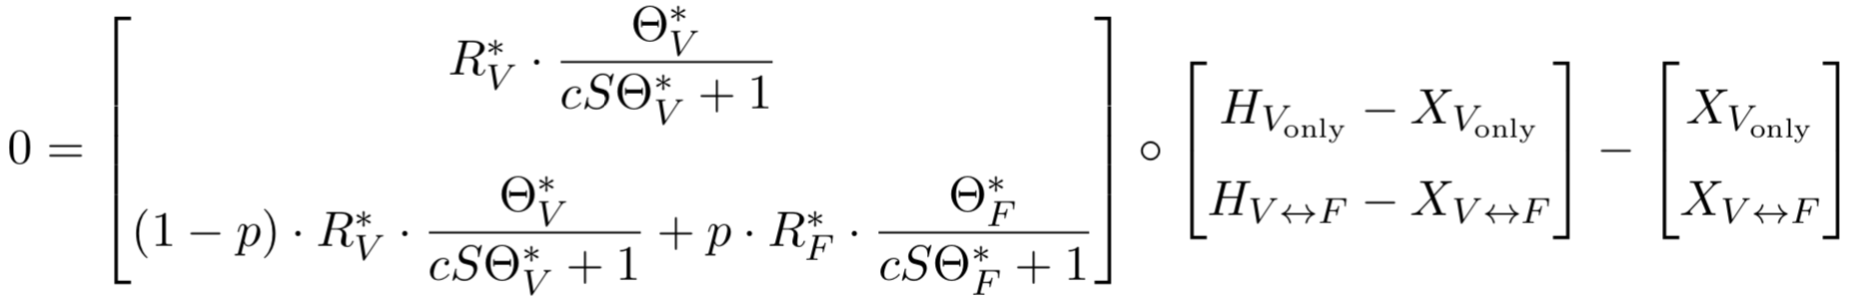
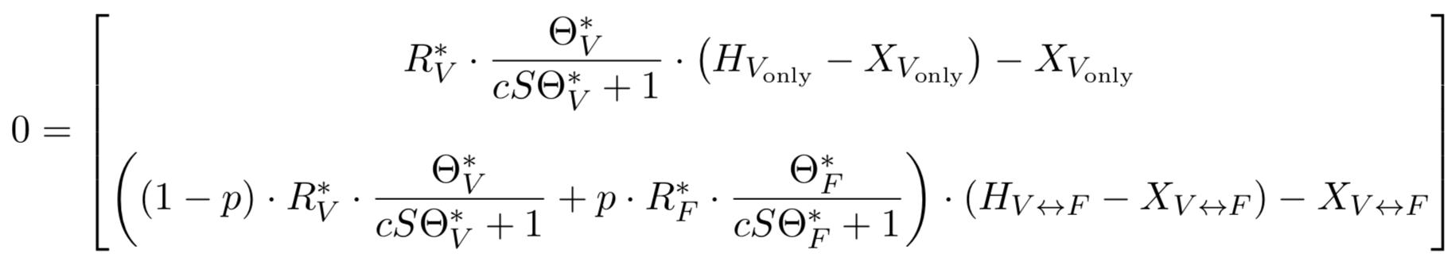
Simple Example: One Village, One Forest
Notes:
Once again relating R and X

Slide 23
Expanded Example

Slide 24
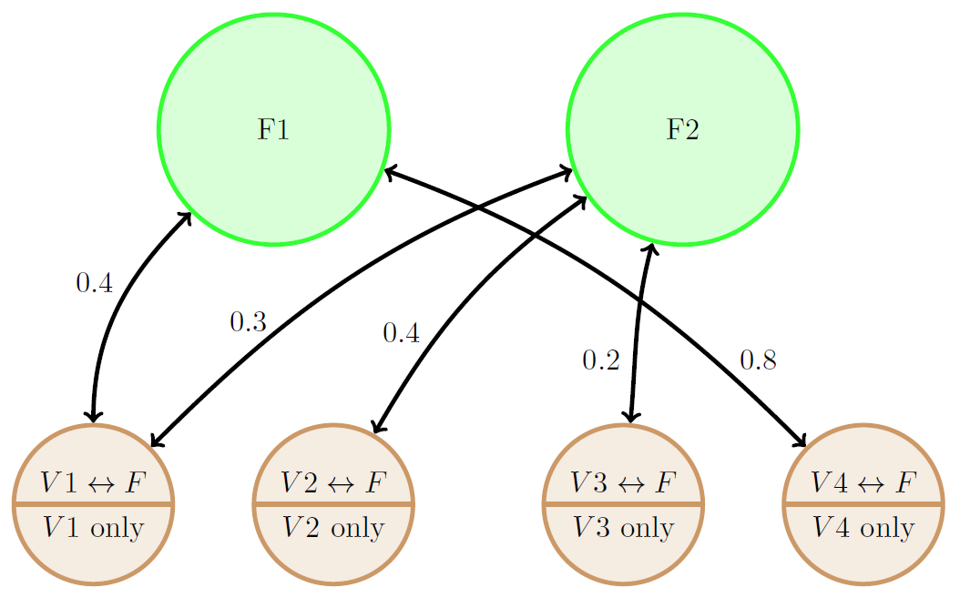
Expand to More Villages and Forests
Notes:
Populations can travel to multiple forests

Slide 25
Expand to More Villages and Forests

Slide 26
Expand to More Villages and Forests

Slide 27
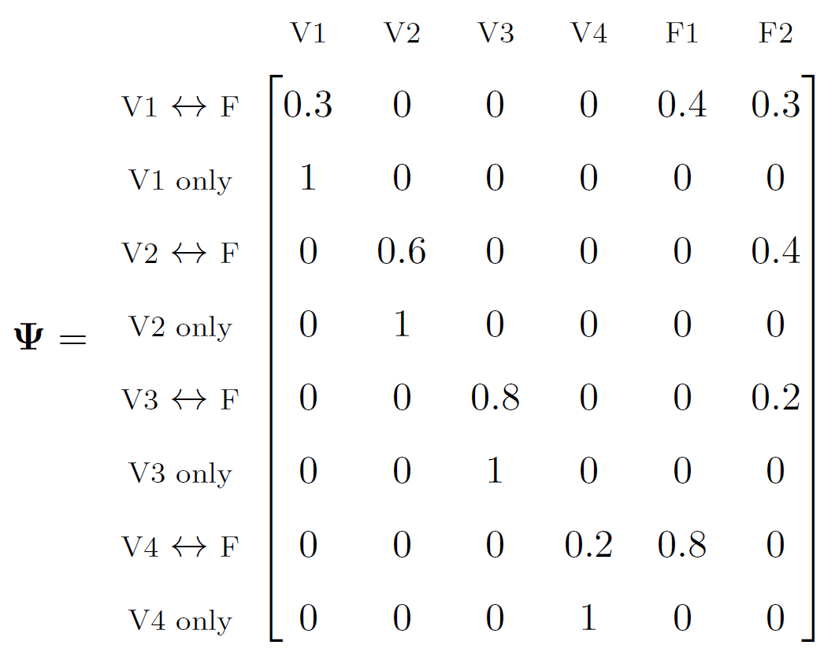
Expand to More Villages and Forests
Notes:
Rows add up to 1

Slide 28
Implementation In R

Slide 29
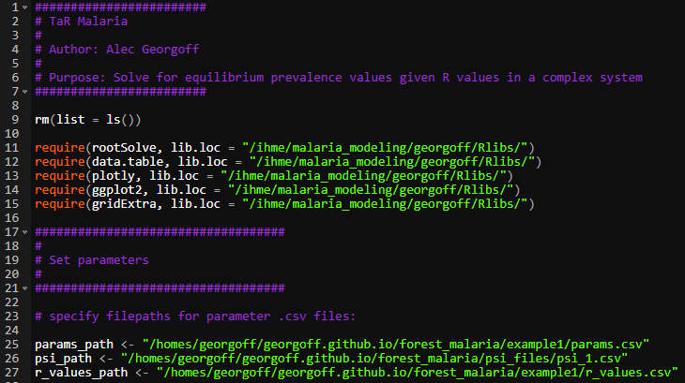
R Code

Slide 30
R Code
Notes:
Parameters are stored in CSVs

Slide 31
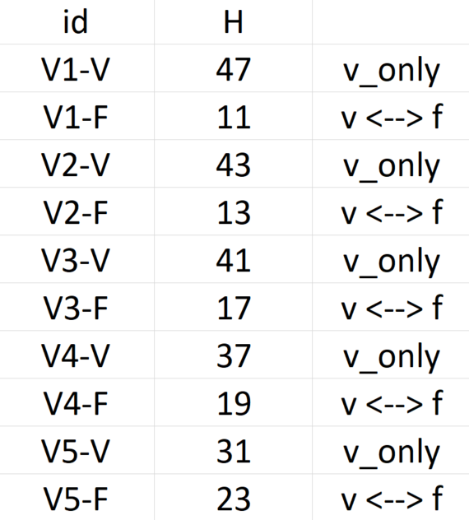
R Code – Parameters
Notes:
UNIQUE human populations

Slide 32
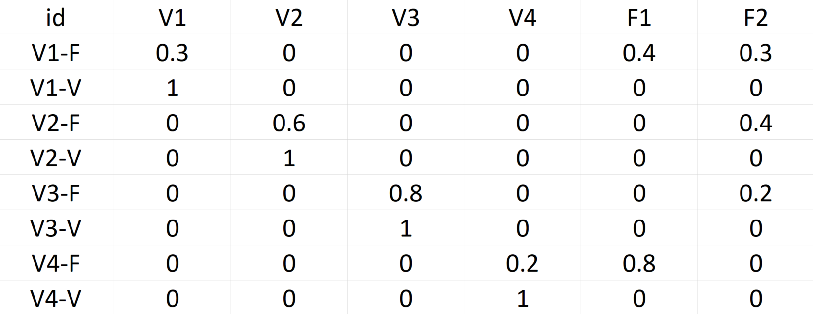
R Code – TaR Matrix
Notes:
TaR matrix

Slide 33
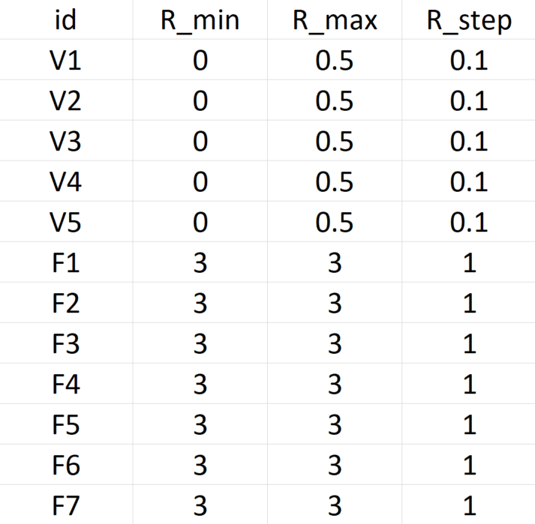
R Code – R Values
Notes:
Explain R ranges and permutations

Slide 34
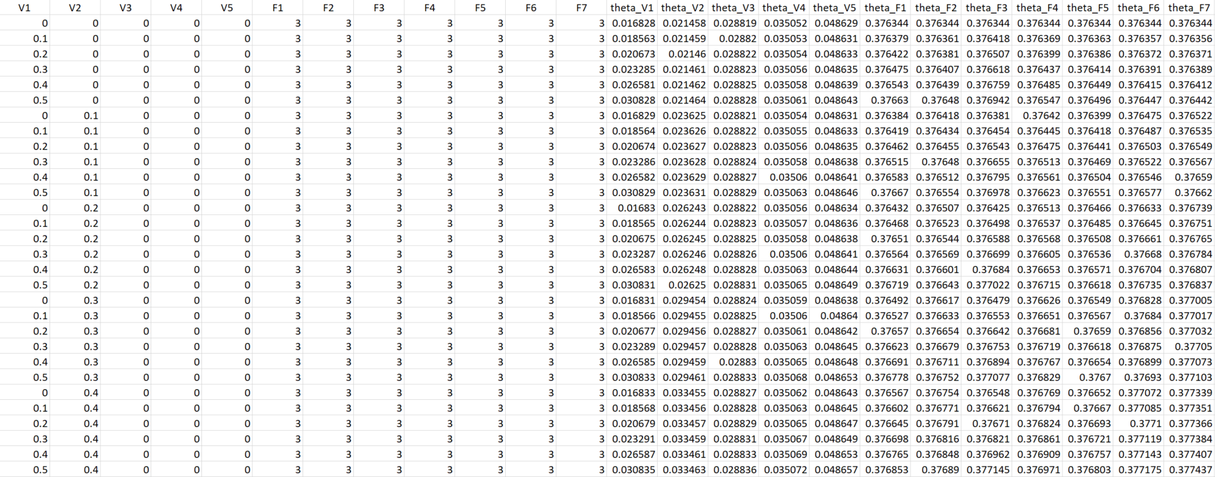
R Code – Results
7776 Rows

Slide 35
Visualizations

Slide 36
Visualizations
Heatmap
3D Surface
Notes:
Simple example gives us some cool visualizations

Slide 37
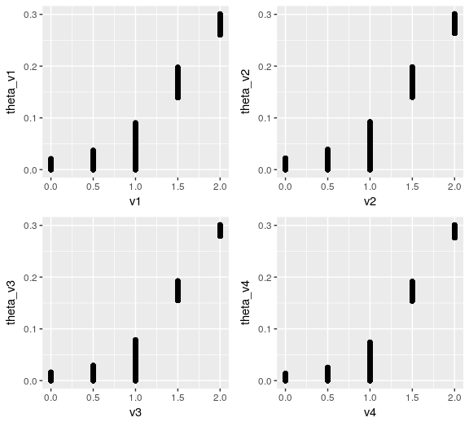
Visualizations
Notes:
Need to do more work on visualizing in higher dimensions

Slide 38
Future Directions

Slide 39
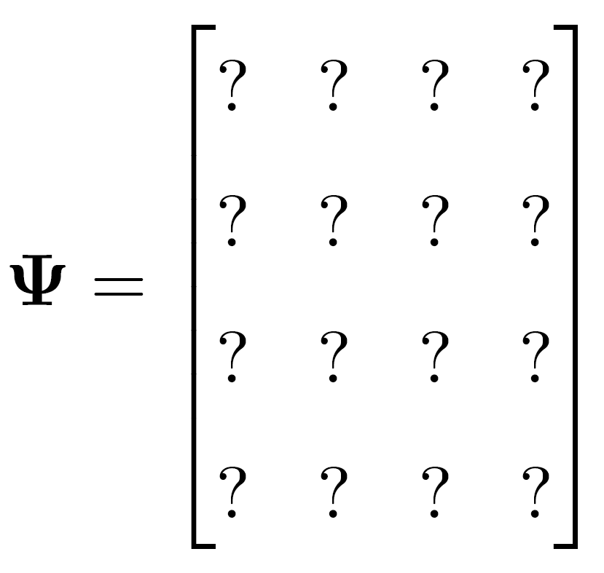
Data, Data, Data
Notes:
TaR matrix is key missing piece

Slide 40
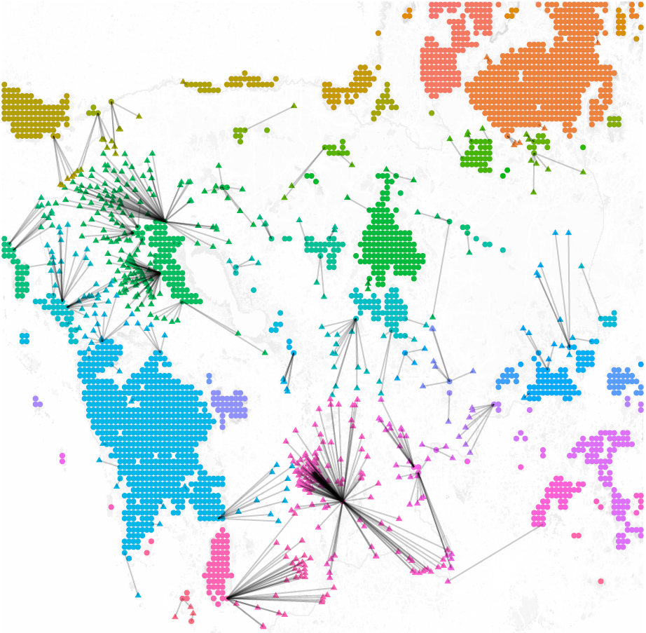
Data, Data, Data
Notes:
Attempt to use high level, publicly available data – not super believable

Slide 41
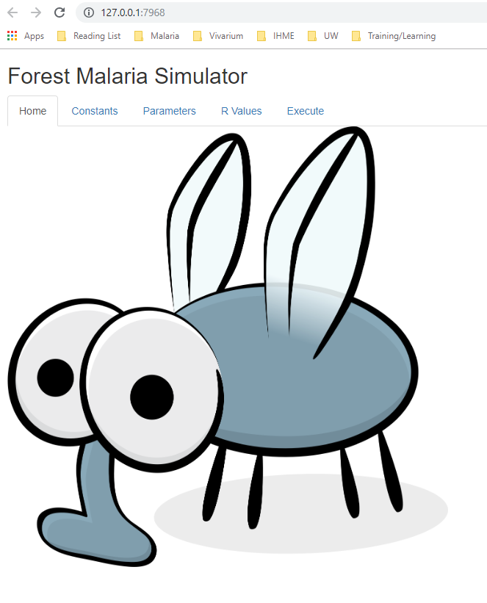
Model Interface
Notes:
Shiny interface

Slide 42

Questions?

Slide 43
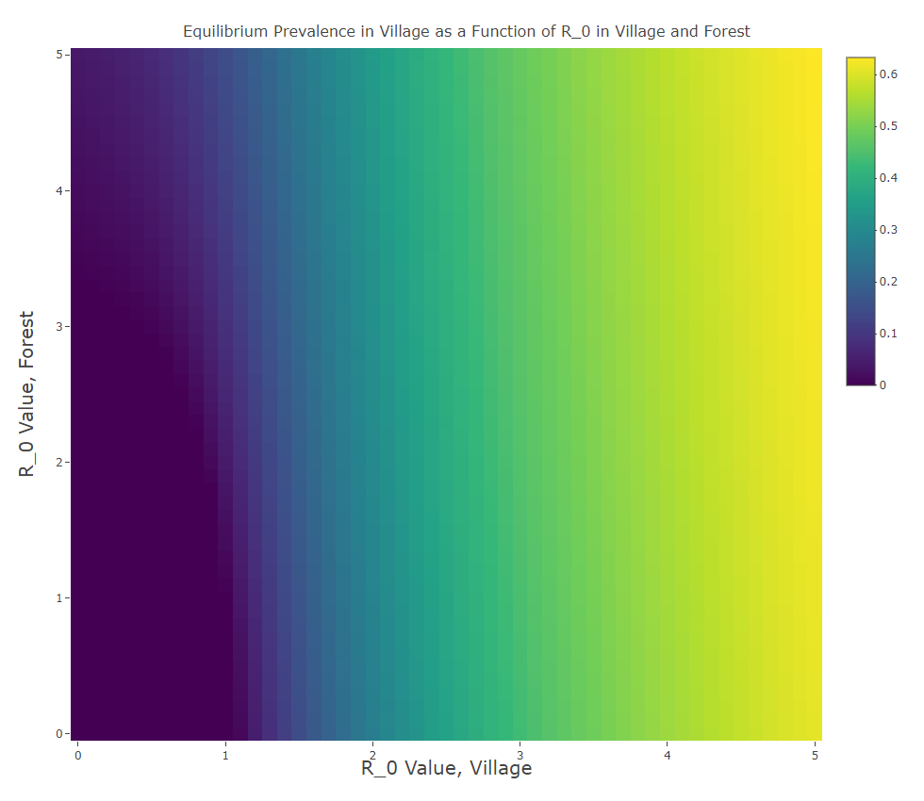

Slide 44
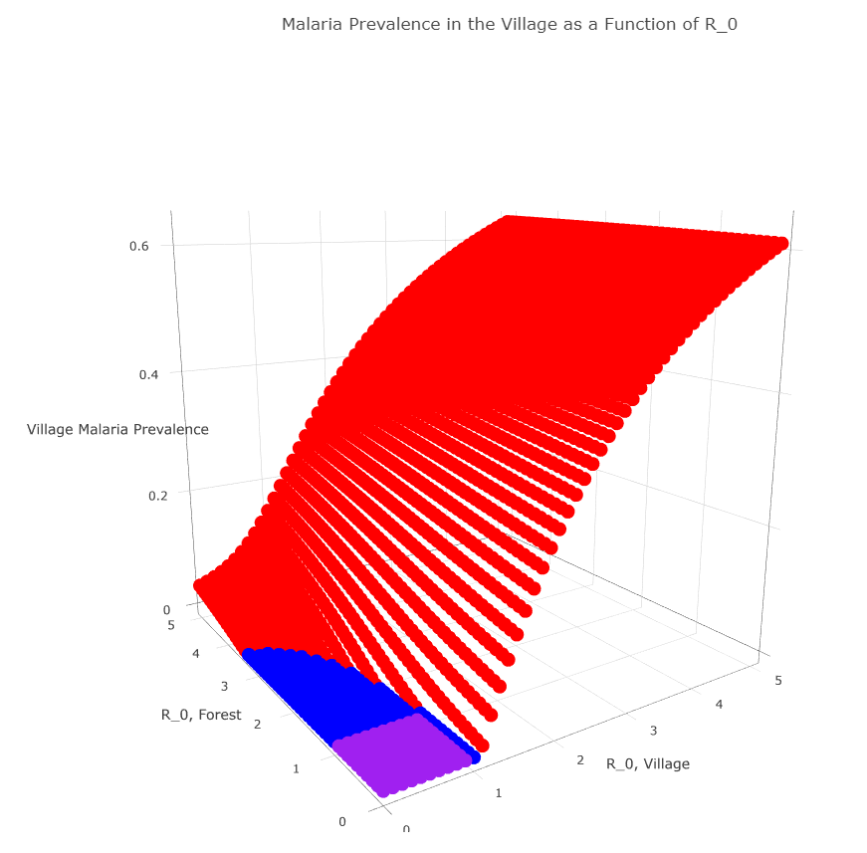

Slide 45

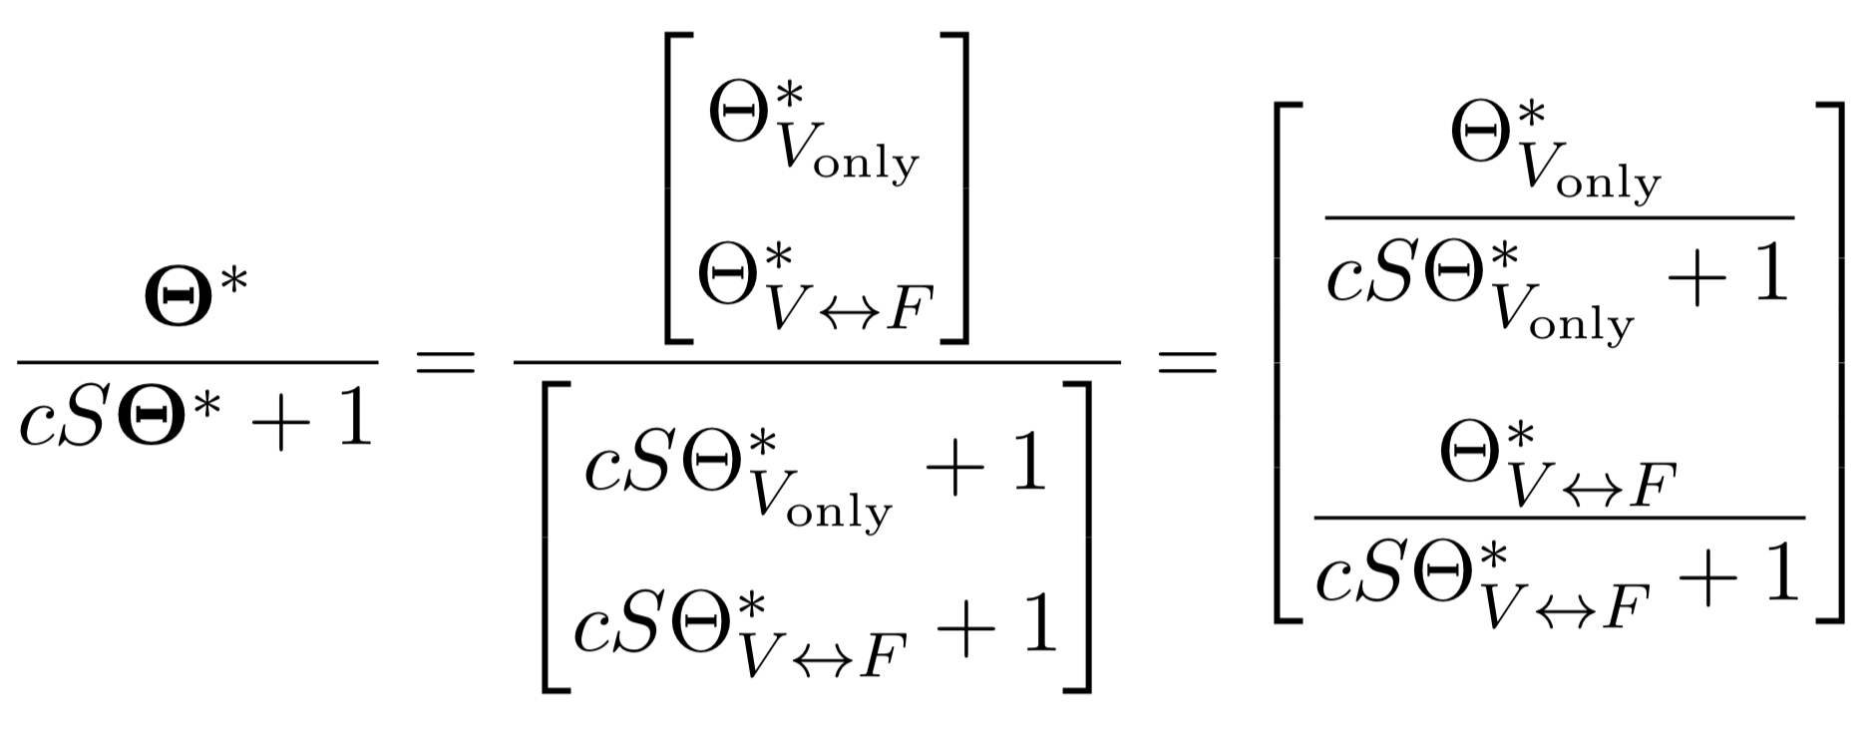
Simple Example: One Village, One Forest
Notes:
delete

Slide 46
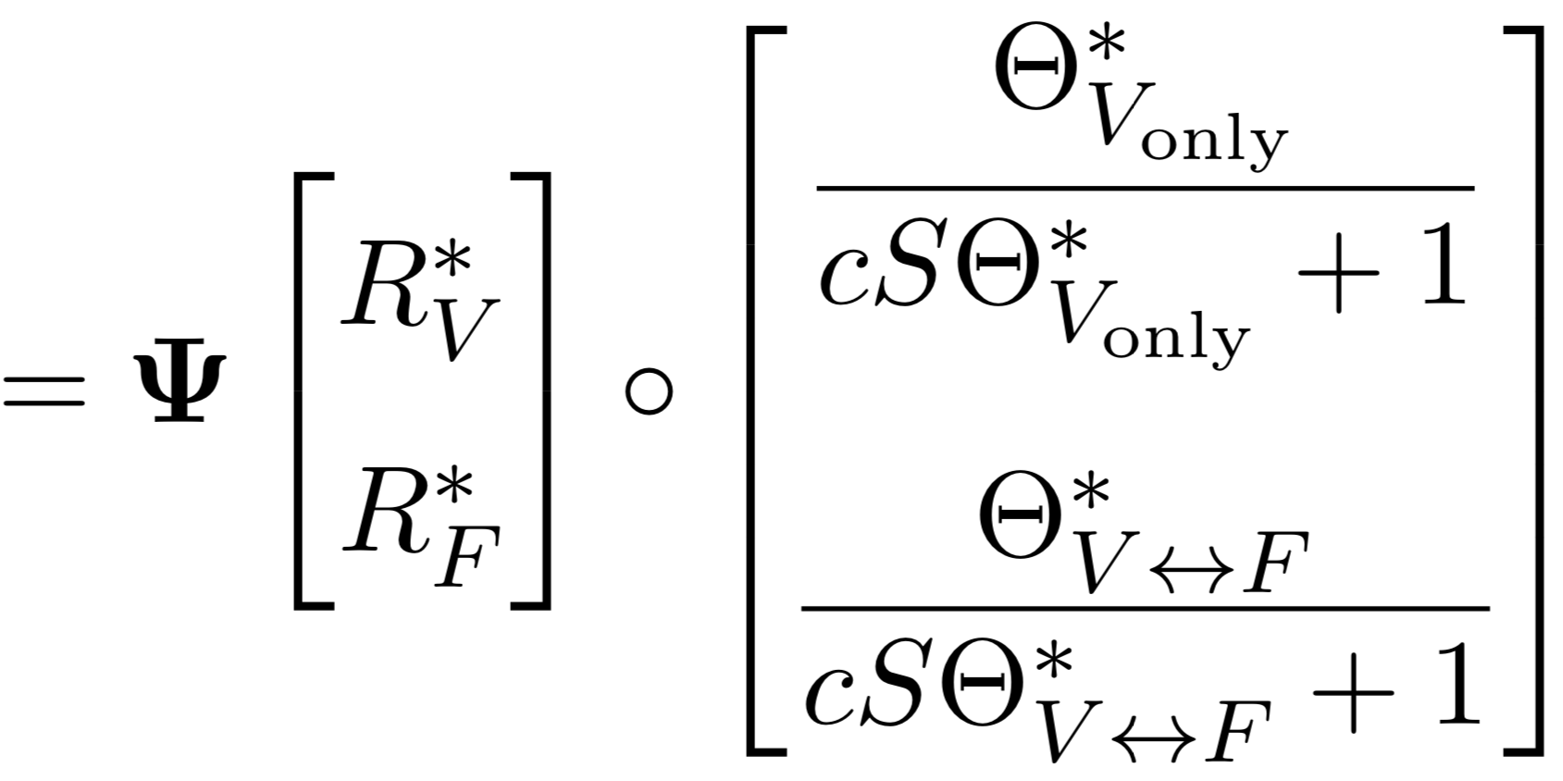
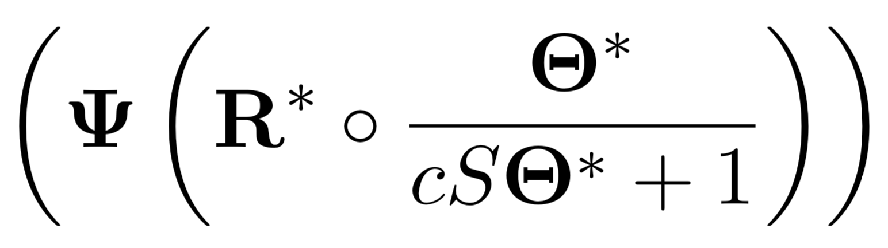
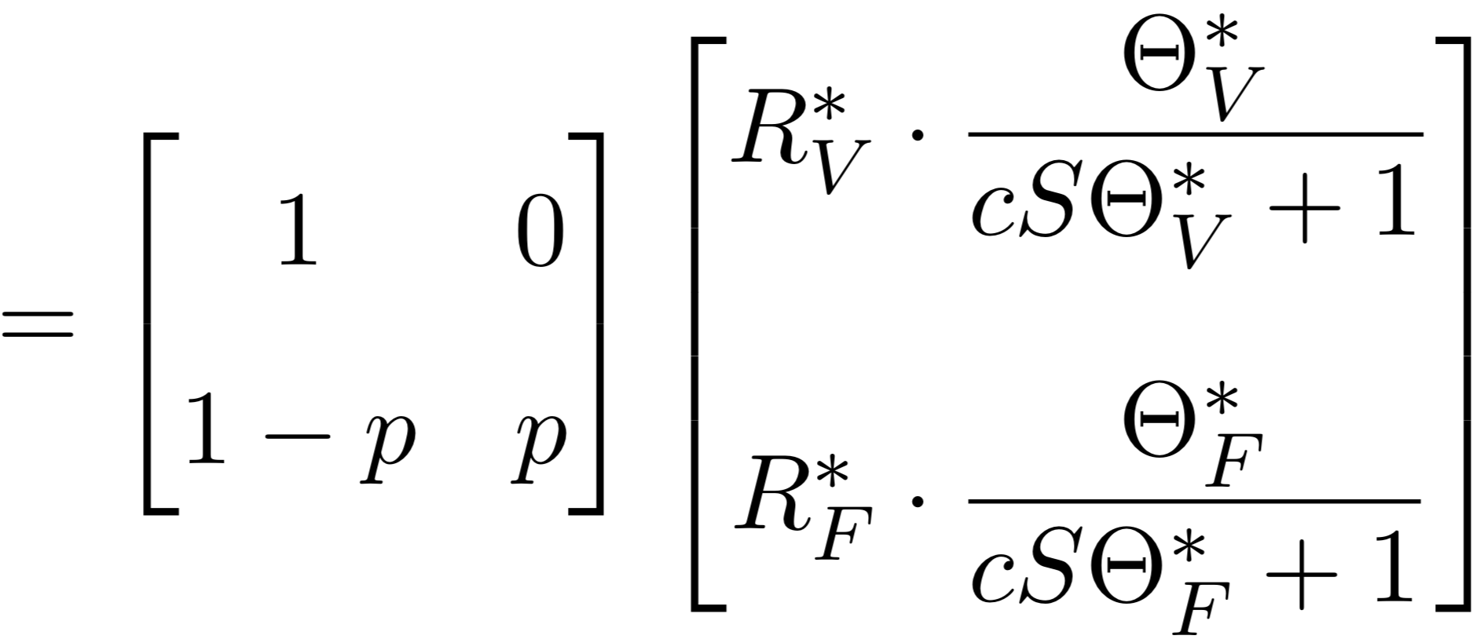
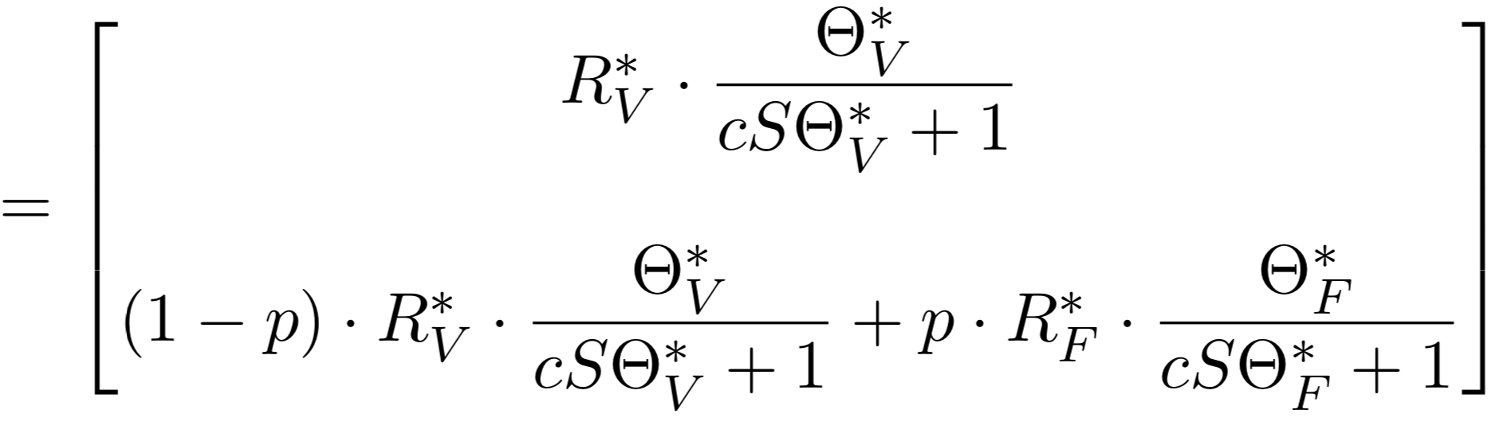
Simple Example: One Village, One Forest
Notes:
delete

Slide 47

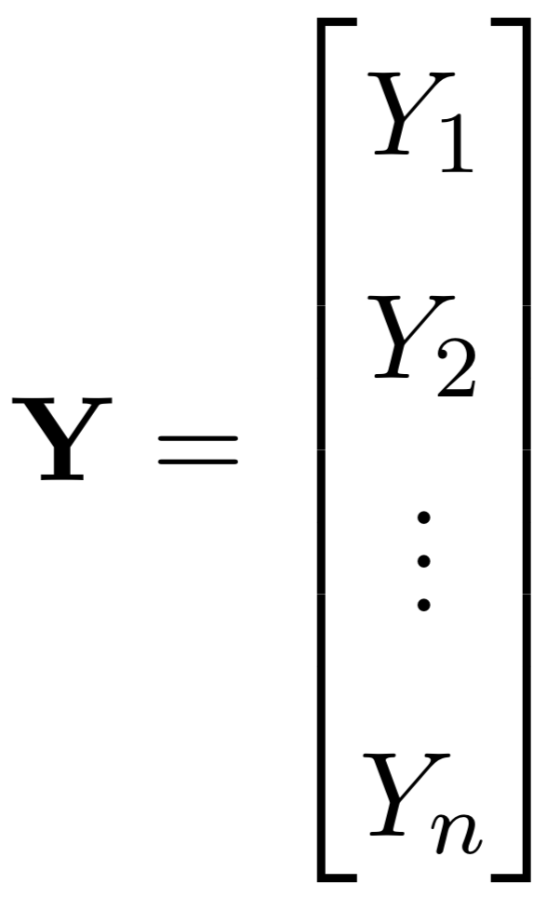
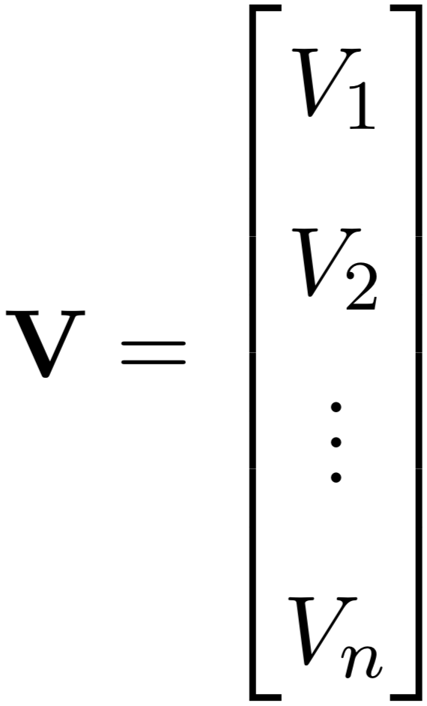
Vectors of Variables

